Slide 1
Borderless Debit card

Slide 2
Borderless card funding / usage flows
We allow cardholder to hold a foreign-currency wallet (e.g. PKR)
The cardholder locks-in GBP->PKR rate
The cardholder uses the card for PKR transactions (POS, ATM etc.)
For authorisation, we use the customer’s PKR balance as source of funds
We authorise against the customer’s available PKR
On T1-3, we must settle the transactions with VISA (in GBP)

Slide 3
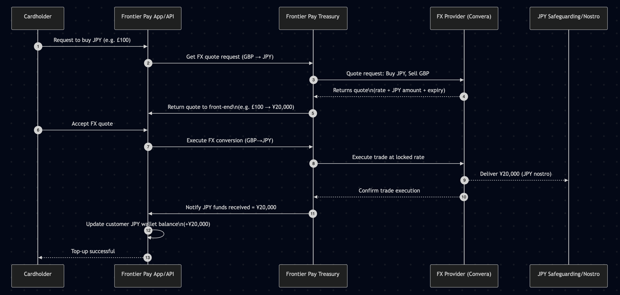
Funding Customer’s JPY balance

Slide 4
FX Risk
To settle with the cardholder, we must transfer PKR funds from safeguarding account to our operating account
To balance the books and settle with Visa, we must convert the PKR to GBP
As settlement may take place 1-3 days after transaction date, the rates may have moved against us

Slide 5
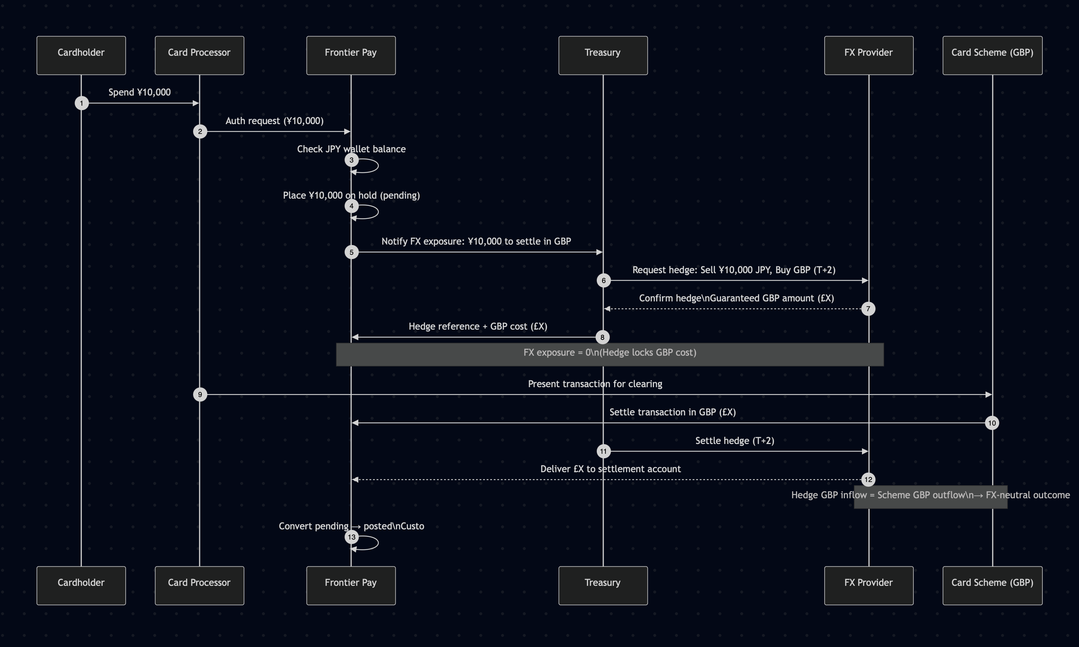
Mitigating FX Risk

Slide 6
Mitigating FX Risk
Customer funds are immediately converted to desired foreign currency
Transactions are authorised based on customer’s currency balance
Customer spend in foreign currency is hedged in real-time
We know exactly what the scheme settlement will cost in GBP
The hedge is recorded against the transaction
At settlement time VISA takes GBP from our settlement a/c
We close out (unwind) the hedge

Slide 7
Example flow (A JPY card authorisation of ¥10,000 comes in)
We authorise the transaction based on customers JPY balance
Customer’s JPY balance is reduced by ¥10,000
Immediately after authorisation we place a FX deal with FX provider: - Sell currency: JPY
- Buy currency: GBP
- Amount: 10,000 JPY
- Settlement date: As per scheme e.g. T+2
FX provider returns:
- Rate (GBP/JPY = 208.30)
- Guaranteed GBP amount: £48
- Reference ID
- Settlement date
We accept the FX quote and lock the rate
We record the hedge against the authorisation
At Settlement:
- FX provider delivers £48 to us
- Scheme takes £48 from us
Note - The FX hedge can be any one of:
NDF, Forward, “guaranteed rate”

